Slide 1

Python Datatypes
Thursday, 8 December 2022

Slide 2
“An investment in knowledge pays the best interest“
- BENJAMIN FRANKLIN

Slide 3
Today’s Agenda
Basic Data Types In Python
Numeric Types
Different Types Of Integers
The float Type
The complex Type
The bool Type
The str Type

Slide 4
Basic Data Types In Python
Although a programmer is not allowed to mention the data type while creating variables in his program in Python , but Python internally allots different data types to variables depending on their declaration style and values.
Overall Python has 14 data types and these are classified into 6 categories.

Slide 5
Basic Data Types In Python
These categories are:
Numeric Types
Boolean Type
Sequence Types
Set Types
Mapping Type
None Type
Given on the next slide are the names of actual data types belonging to the above mentioned categories

Slide 6
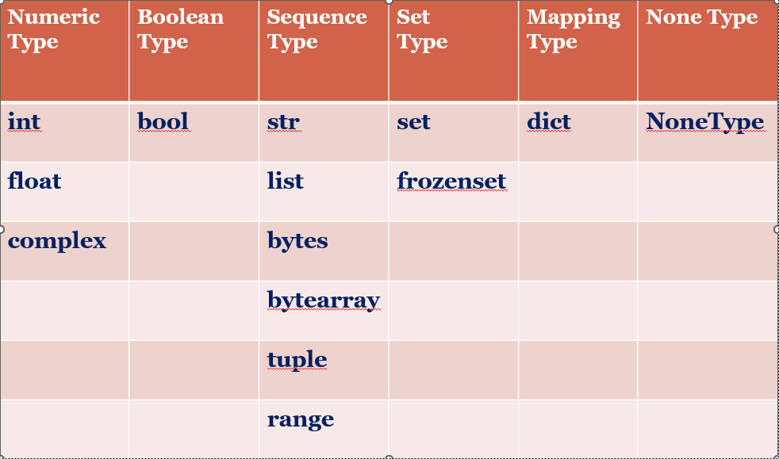
Basic Data Types In Python
Numeric Type
Boolean Type
Sequence Type
Set
Type
Mapping Type
None Type

Slide 7
Some Very Important Points
Before we explore more about these data types , let us understand following important points regarding Python’s data types:
DATA TYPES IN PYTHON ARE DYNAMIC
SIZE OF THE DATA TYPE IS ALSO DYNAMICALLY MANAGED
DATA TYPES ARE UNBOUNDED

Slide 8
Some Very Important Points
DATA TYPES IN PYTHON ARE DYNAMIC
The term dynamic means that we can assign different values to the same variable at different points of time.
Python will dynamically change the type of variable as per the value given.

Slide 9
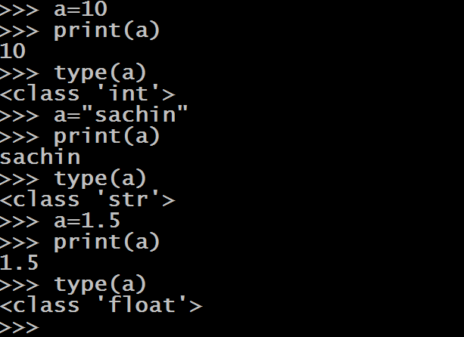
Some Very Important Points
type() is a built –in function and it returns the data type of the variable
Another important observation we can make is that in Python all the data types are implementted as classes and all variables are object

Slide 10
Some Very Important Points
SIZE OF THE DATA TYPE IS ALSO DYNAMICALLY MANAGED
In Python the size of data types is dynamically managed
Like C/C++/Java language , variables in Python are not of fixed size.
Python makes them as big as required on demand
There is no question of how much memory a variable uses in Python because this memory increases as per the value being assigned

Slide 11
Some Very Important Points
Python starts with initial size for a variable and then increases its size as needed up to the RAM limit
This initial size for int is 24 bytes and then increases as the value is increased
If we want to check the size of a variable , then Python provides us a function called getsizeof() .
This function is available in a module called sys

Slide 12
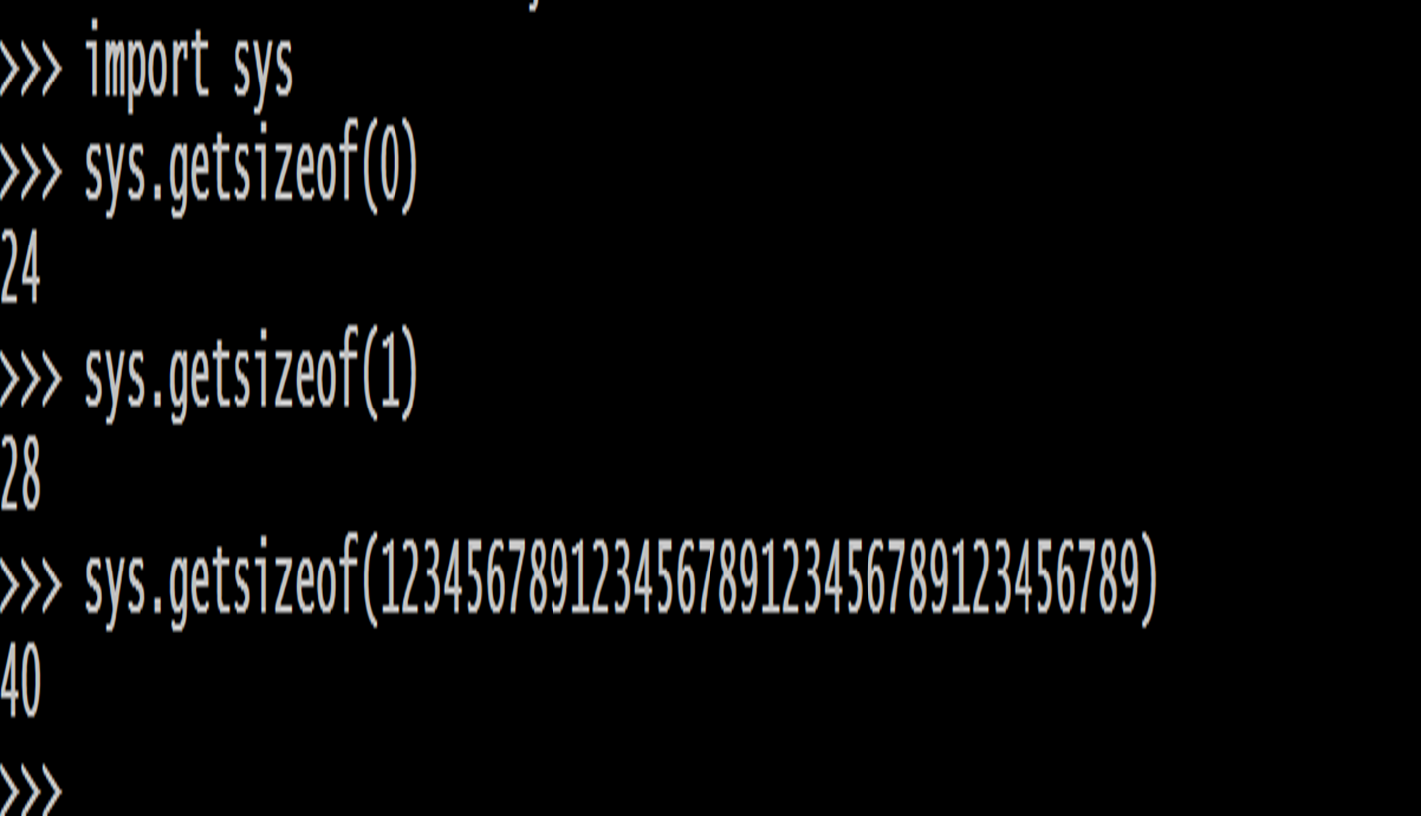
Some Very Important Points

Slide 13
Some Very Important Points
DATA TYPES ARE UNBOUNDED
Third important rule to remember is that , in Python data types like integers don’t have any range i.e. they are unbounded
Like C /C++ /Java they don’t have max or min value
So an int variable can store as many digits as we want.

Slide 14
Numeric Types In Python
As previously mentioned , Python supports 3 numeric types:
int: Used for storing integer numbers without any fractional part
float: Used for storing fractional numbers
complex: Used for storing complex numbers

Slide 15
Numeric Types In Python
EXAMPLES OF int TYPE:
a=10
b=256
c=-4
print(a)
print(b)
print(c)

Slide 16
The float Data Type
Python also supports floating-point real values.
Float values are specified with a decimal point
So 2.5 , 3.14 , 6.9 etc are all examples of float data type
Just like double data type of other languages like Java/C , float in Python has a precision of 16 digits

Slide 17

Some Important Points About float
Float values can also be represented as exponential values
Exponential notation is a scientific notation which is represented using e or E followed by an integer and it means to the power of 10

Slide 18
The complex Data Type
Complex numbers are written in the form, x + yj, where x is the real part and y is the imaginary part.
For example: 4+3j , 12+1j etc
The letter j is called unit imaginary number.
It denotes the value of √-1 , i.e j² denotes -1

Slide 19
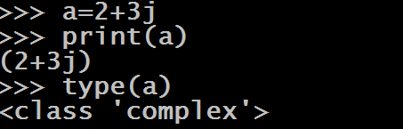
An Example

Slide 20
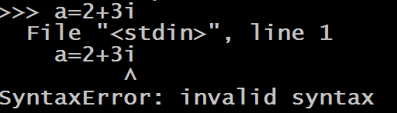
Some Important Points About complex Data Type
For representing the unit imaginary number we are only allowed to use the letter j (both upper and lower case are allowed).
Any other letter if used will generate error

Slide 21
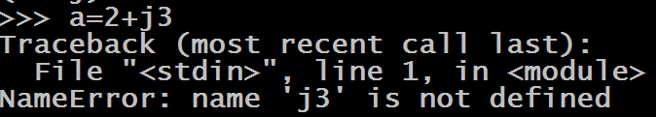
Some Important Points About complex Data Type
The letter j , should only appear in suffix , not in prefix

Slide 22

Some Important Points About complex Data Type
The real and imaginary parts are allowed to be integers as well as floats

Slide 23
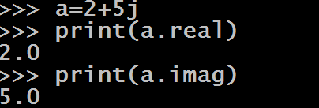
Some Important Points About complex Data Type
We can display real and imaginary part separately by using the attributes of complex types called “real” and “imag”.
Don’t think real and imag are functions , rather they are attributes/properties of complex data type

Slide 24
The bool Data Type
In Python , to represent Boolean values we have bool data type.
The bool data type can be one of two values, either True or False.
We use Booleans in programming to make comparisons and to control the flow of the program.

Slide 25
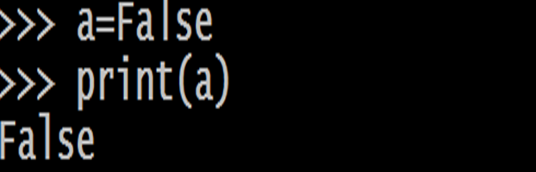
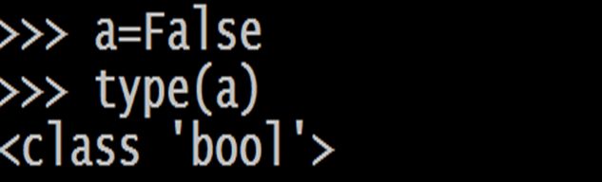
Some Examples

Slide 26
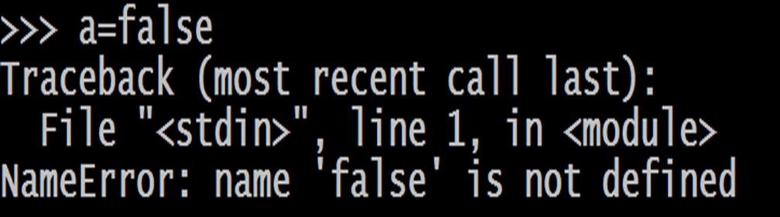
Some Important Points About bool
True and False are keywords , so case sensitivity must be remembered while assigning them otherwise Python will give error

Slide 27
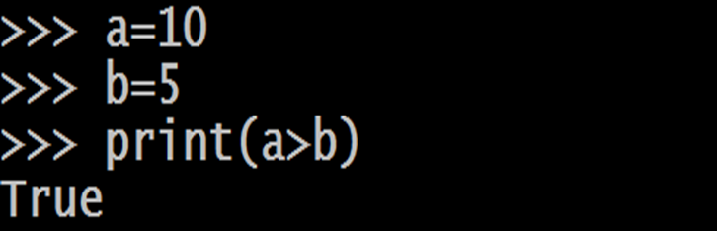
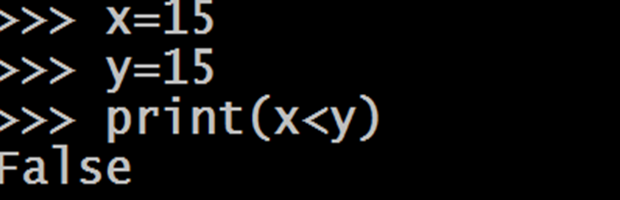
Some Important Points About bool
All test conditions in Python return the result as bool which could be either True or False

Slide 28
Some Important Points About bool
To understand the next point , try to guess the output of the following:
a=True
b=False
c=a+b
print(c)
a=True
b=True
c=a+b
print(c)
a=False
b=False
c=a+b
print(c)
The above outputs make it clear that internally Python stores True and False as integers with the value 1 and 0 respectively

Slide 29
The str Data Type
Just like any other language , In Python also a String is sequence of characters.
Python does not have a char data type, unlike C/C++ or Java
We can use single quotes or double quotes to represent strings.
However Python recommends to use single quotes

Slide 30
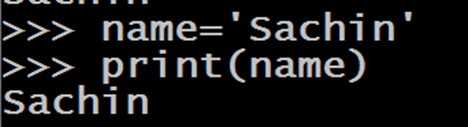
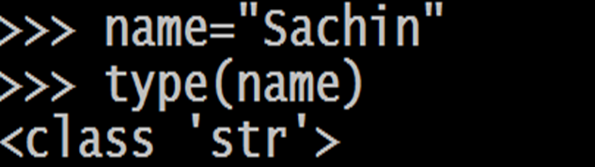
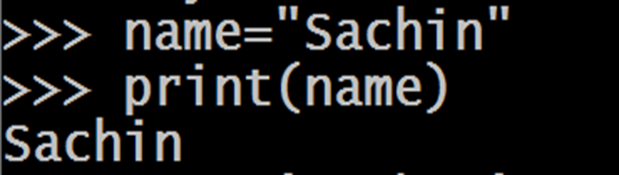
Some Examples
The data type used by Python internally for storing Strings is str

Slide 31
Some Important Points About Strings
Unlike C language , Python does not uses ASCII number system for characters . It uses UNICODE number system
UNICODE is a number system which supports much wider range of characters compared to ASCII
As far as Python is concerned , it uses UNICODE to support 65536 characters with their numeric values ranging from 0 to 65535 which covers almost every spoken language in the world like English , Greek , Spanish , Chinese , Japanese etc

Slide 32
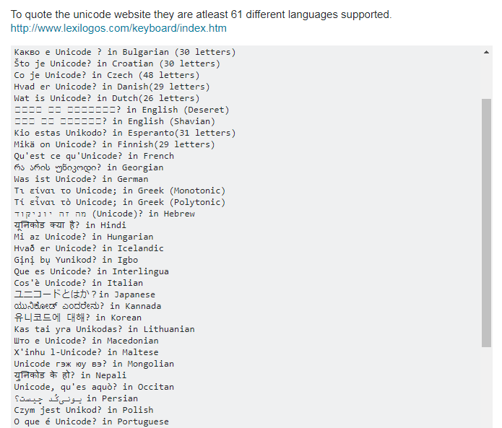
Some Important Points About Strings

Slide 33
Some Important Points About Strings
If a string starts with double quotes , it must end with double quotes only .
Similarly if it starts with single quotes , it must end with single quotes only.
Otherwise Python will generate error

Slide 34
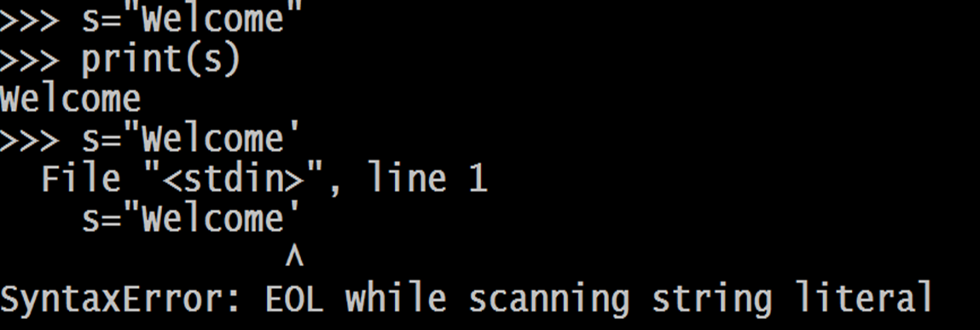
Some Important Points About Strings

Slide 35
Some Important Points About Strings
If the string contains single quotes in between then it must be enclosed in double quotes and vice versa.
For example:
To print Sunny's Python Classes , we would write:
msg= " Sunny's Python Classes "
Similarly to print Capital of "MP" is "Bhopal" ,we would write:
msg= ‘Capital of "MP" is "Bhopal" '

Slide 36
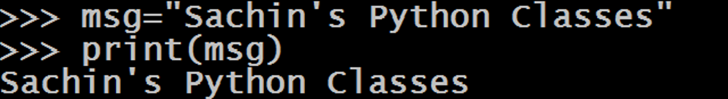
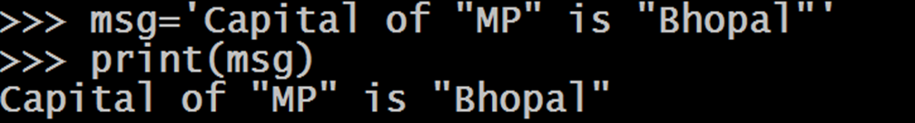
Some Important Points About Strings

Slide 37
Some Important Points About Strings
How will you print Let's learn "Python" ?
"Let's learn "Python" "
'Let's learn "Python" '
NONE!
Both will give error.
Correct way is to use either triple single quotes or triple
double quotes or escape sequence character \
msg=' ' 'Let's learn "Python" ' ' '
OR
msg='Let\'s learn "Python" '

Slide 38
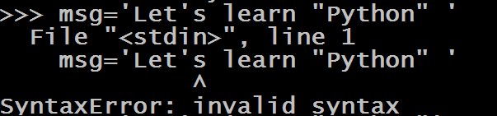
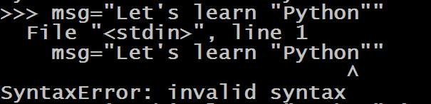
Some Important Points About Strings

Slide 39



Some Important Points About Strings

Slide 40
Some Important Points About Strings
Another important use of triple single quotes or triple double quotes is that if our string extends up to more than one line then we need to enclose it in triple single quotes or triple double quotes
A = “””my
name
is
sunny”””
A = “my\n name\n is\n sunny”

Slide 41
Accessing Individual Characters In String
In Python, Strings are stored as individual characters in a contiguous memory location.
Each character in this memory location is assigned an index which begins from 0 and goes up to length -1

Slide 42
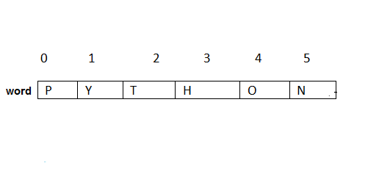
Accessing Individual Characters In String
For example, suppose we write
word=“Python”
Then the internal representation of this will be

Slide 43
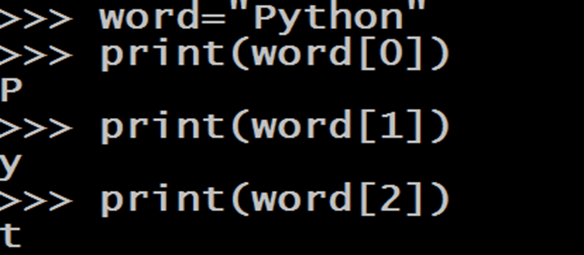
Accessing Individual Characters In String
Now to access individual character we can provide this index number to the subscript operator [ ].

Slide 44
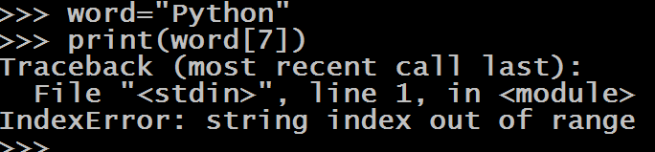
Accessing Individual Characters In String
However if we try to provide an index number beyond the given limit then IndexError exception will arise

Slide 45
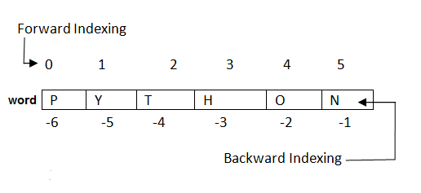
Accessing Individual Characters In String
Not only this , Python even allows negative indexing which begins from the end of the string.
So -1 is the index of last character , -2 is the index of second last character and so on.

Slide 46
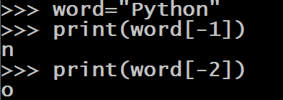
Accessing Individual Characters In String

Slide 47
Type Conversion
The process of converting the value of one data type (integer, string, float, etc.) to another data type is called Type Conversion.
Python has two types of type conversion.
Implicit Type Conversion
Explicit Type Conversion

Slide 48
Implicit Conversion
In Implicit Type Conversion, Python automatically converts one data type to another data type.
This process doesn't need any programmer involvement.
Let's see an example where Python promotes conversion of int to float .

Slide 49
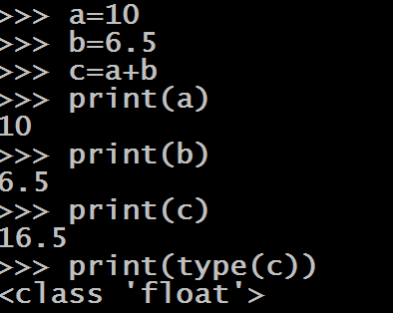
Example Of Implicit Conversion
If we observe the above operations , we will find that Python has automatically assigned the data type of c to be float .
This is because Python always converts smaller data type to larger data type to avoid the loss of data.

Slide 50
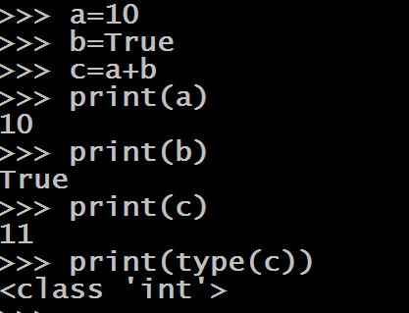
Another Example
Here also Python is automatically upgrading bool to type int so as to make the result sensible

Slide 51
Explicit Type Conversion
There are some cases , where Python will not perform type conversion automatically and we will have to explicitly convert one type to another.
Such Type Conversions are called Explicit Type Conversion
Let's see an example of this

Slide 52
Explicit Type Conversion
Guess the output ?
a=10
b=“6”
print(type(a))
print(type(b))
c=a+b
print( c )
print(type( c ))
Output:
<class ‘int’>
<class ‘str’>
TypeError: unsupported operand type(s) for +: 'int' and 'str'
Why did the code fail?
The code failed because
Python does not automatically convert
String to int.
To handle such cases we need to
perform Explicit Type Conversion

Slide 53
Explicit Type Conversion Functions In Python
Python provides us 5 predefined functions for performing Explicit Type Conversion for fundamental data types.
These functions are :
int()
float()
complex()
bool()
str()

Slide 54
The int( ) Function
Syntax: int(value)
This function converts value of any data type to integer , with some special cases
It returns an integer object converted from the given value

Slide 55
int( ) Examples
int(2.3)
Output:
2
int(False)
Output:
0
int(True)
Output:
1
int(3+4j)
Output:
TypeError: Can’t convert complex to int
int() cannot convert complex type to int type

Slide 56
int( ) Examples
int() cannot accept anything other than digits in a string
int(“25”)
Output:
25
int(“2.5”)
Output:
ValueError: Invalid literal for int()
int(“1010”)
Output:
1010
int(“0b1010”)
Output:
ValueError: Invalid literal for int()
int() cannot accept binary values as string

Slide 57
Solution To The Previous Problem
Can you solve this error now ?
a=10
b=“6”
c=a+b
print( c )
Output:
TypeError
Solution:
a=10
b=“6”
c=a+int(b)
print( c )
Output:
16

Slide 58
The float( ) Function
Syntax: float(value)
This function converts value of any data type to float , with some special cases
It returns an float object converted from the given value

Slide 59
float( ) Examples
float(25)
Output:
25.0
float(False)
Output:
0.0
float(True)
Output:
1.0
float(3+4j)
Output:
TypeError: Can’t convert complex to float
float() cannot convert complex type to float type

Slide 60
float( ) Examples
float(“25”)
Output:
25.0
float(“2.5”)
Output:
2.5
float(“1010”)
Output:
1010.0
float (“0b1010”)
Output:
ValueError:Could not convert string to float
float(“twenty”)
Output:
ValueError:Could not convert string to float
float() cannot accept any int value other than base 10 as string

Slide 61
The complex( ) Function
Syntax: complex(value)
This function converts value of any data type to complex , with some special cases
It returns an complex object converted from the given value

Slide 62
complex ( ) Examples
complex(25)
Output:
(25+0j)
complex(2.5)
Output:
(2.5+0j)
complex(True)
Output:
(1+0j)
complex(False)
Output:
0j

Slide 63
complex( ) Examples
complex(“twenty”)
Output:
ValueError: complex() arg is a malformed string
complex(“25”)
Output:
(25+0j)
complex(“2.5”)
Output:
(2.5+0j)
complex(“1010”)
Output:
(1010+0j)
complex (“0b1010”)
Output:
ValueError: complex() arg is a malformed string
complex() cannot accept any int value other than base 10 as string

Slide 64
The bool ( ) Function
Syntax: bool(value)
This function converts value of any data type to bool , using the standard truth testing procedure.
It returns an bool object converted from the given value

Slide 65
The bool ( ) Function
What values are considered to be false and what values are true ?
The following values are considered false in Python:
None
False
Zero of any numeric type. For example, 0, 0.0, 0+0j
Empty sequence. For example: (), [], ''.
Empty mapping. For example: {}
All other values are true

Slide 66
bool( ) Examples
bool(1)
Output:
True
bool(5)
Output:
True
bool(0)
Output:
False
bool(0.0)
Output:
False

Slide 67
bool( ) Examples
bool(0.1)
Output:
True
bool(0b101)
Output:
True
bool(0b0000)
Output:
False
bool(2+3j)
Output:
True
bool() returns True if any of the real or imaginary part is non zero . If both are zero it returns False

Slide 68
bool( ) Examples
bool(“twenty”)
Output:
True
bool(' ')
Output:
True
bool(0+1j)
Output:
True
bool(0+0j)
Output:
False
bool('')
Output:
False
bool('A')
Output:
True
bool() returns False for empty Strings otherwise it returns True

Slide 69
The str( ) Function
Syntax: str(value)
This function converts any data type to string , without any special cases
It returns a String object converted from the given value

Slide 70
str( ) Examples
str(15)
Output:
‘15’
str(2.5)
Output:
‘2.5’
str(2+3j)
Output:
‘(2+3j)’
str(True)
Output:
‘True’

Slide 71
str( ) Examples
str(1)
Output:
‘1’
str(5)
Output:
‘5’
str(2.5)
Output:
‘2.5’
str(True)
Output:
‘True’

Slide 72
Thank you

